Slide 1


12
Debugging
and
Handling Exceptions
C# Programming: From Problem Analysis to Program Design
4th Edition

Slide 2
Chapter Objectives
Learn about exceptions, including how they are thrown and caught
Gain an understanding of the different types of errors that are found in programs
Look at debugging methods available in Visual Studio
Discover how the Debugger can be used to find run-time errors

Slide 3
Chapter Objectives (continued)
Become aware of and use exception-handling techniques to include try…catch…finally clauses
Explore the many exception classes and learn how to write and order multiple catch clauses

Slide 4
Errors
Visual Studio IDE reports errors as soon as it is able to detect a problem
Syntax errors – compiler errors
Language rule violation
Easier to discover and eliminate
C# adheres to set of rules known as C# Language Specifications
http://msdn.microsoft.com/en-us/library/ms228593.aspx

Slide 5
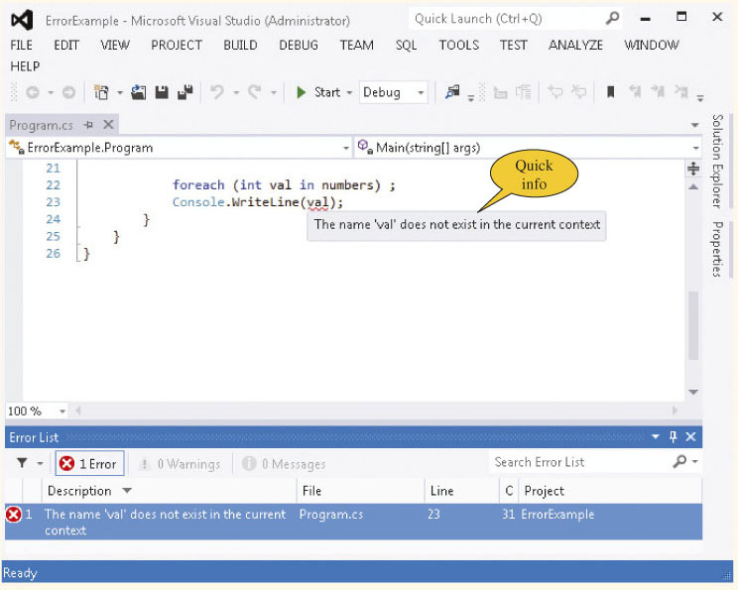
Errors (continued)
Error message does not always state the correct problem
Figure 12-1 Syntax error – extraneous semicolon

Slide 6
Run-Time Errors
Just because your program reports no syntax errors does not necessarily mean it is running correctly
One form of run-time error is a logic error
Program runs but produces incorrect results
May be off-by-one in a loop
Sometimes users enter incorrect values
Finding the problem can be challenging

Slide 7
Debugging in C#
Desk check
Many IDEs have Debuggers
Debuggers let you observe the run-time behavior
You can break or halt execution
You can step through the application
You can evaluate variables
You can set breakpoints
Debug menu offers debugging options

Slide 8
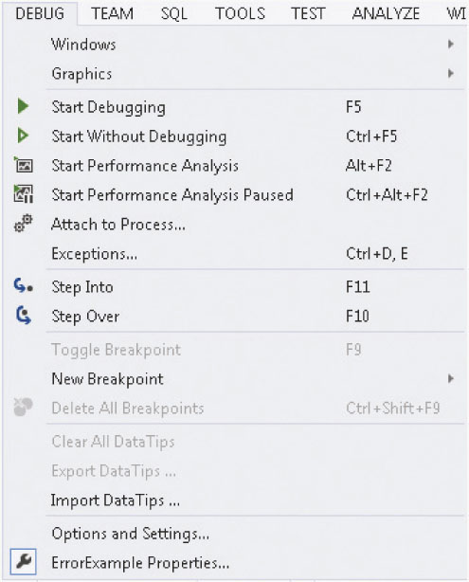
Debugging in C# (continued)
Figure 12-2 Debug menu options

Slide 9
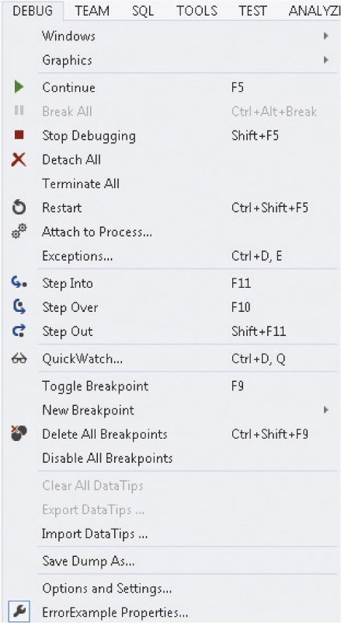
Execution Control
Select Start Debugging and the number of options to run your program doubles
Figure 12-3 Debug menu options during debugging mode

Slide 10
Breakpoints
Markers placed in an application, indicating the program should halt execution when it reaches that point
Break mode
Examine expressions
Check intermediate results
Use Debug menu to set Breakpoint
F9 (shortcut)
Toggles

Slide 11
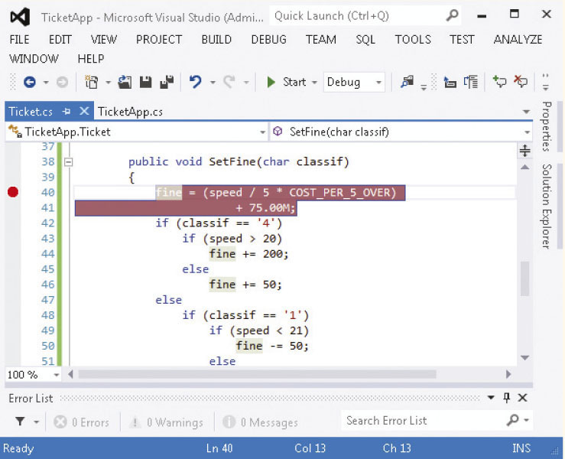
Breakpoints (continued)
Red glyph placed on the breakpoint line
Figure 12-4 Breakpoint set

Slide 12
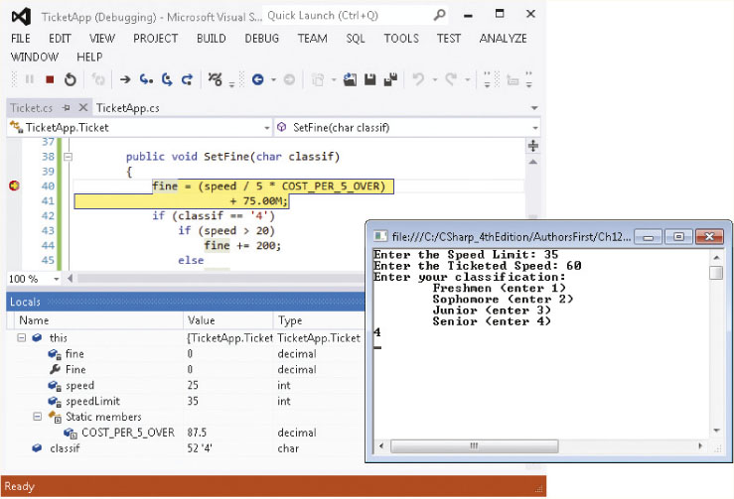
Break Mode
Chapter 5 TicketAppExample
In Break mode, Debugger halts program on the breakpoint line
Locals window shows all variables and their values
Figure 12-5 Locals window at the breakpoint

Slide 13
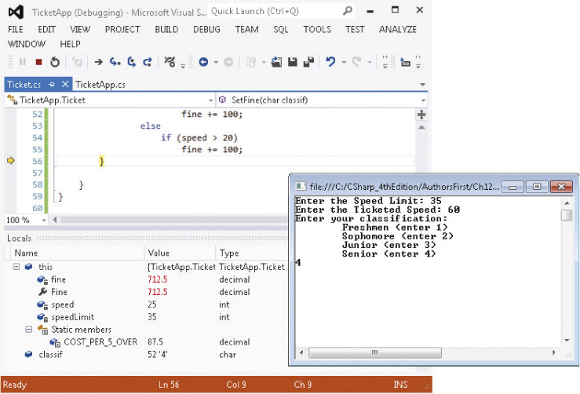
Continue
Selecting Continue or F5 causes program to execute from halted line to next breakpoint (or end of Main( ), if no other breakpoints are set
Figure 12-6 Next breakpoint

Slide 14
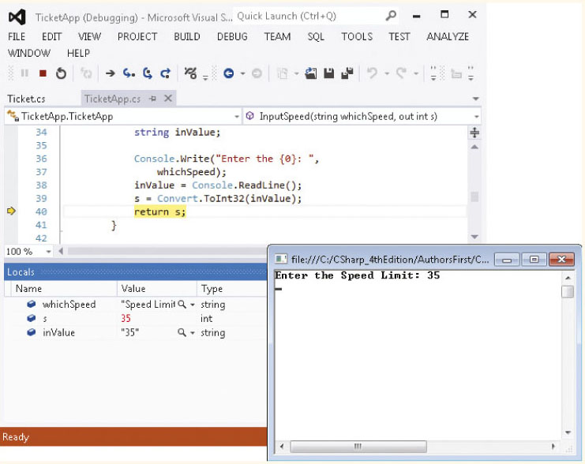
Stepping Through Code
Step Into (F11)
Step Over (F10)
Step Out (Shift+F11)
Figure 12-7 Breakpoint location

Slide 15
Stepping Through Code
Step Into (F11)
Program halts at the first line of code inside the called method
Step Over (F10)
Executes the entire method called before it halts
Step Out (Shift+F11)
Causes the rest of the program statements in the method to be executed, and then control returns to the method that made the call- at that point, it halts the program

Slide 16
Watches
Can set Watch windows during debugging sessions
Watch window lets you type in one or more variables or expressions to observe while the program is running
Watch window differs from Locals window, which shows all variables currently in scope
Quick Watch option on DEBUG menu lets you type a single variable or expression

Slide 17
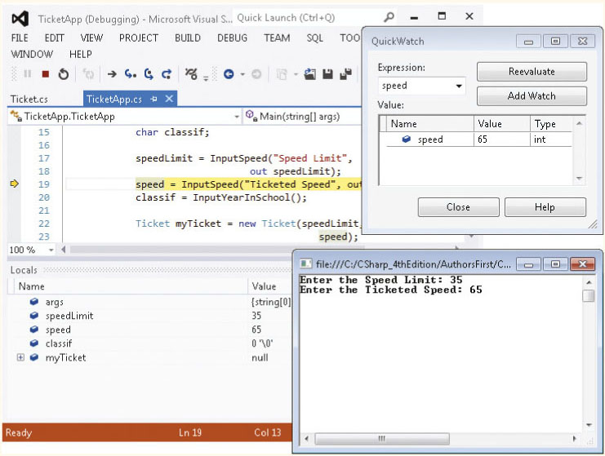
Watches (continued)
Hover mouse over any variable while in break
mode to see its current value
Figure 12-8 QuickWatch window

Slide 18
Exceptions
Can take several actions to keep your program from crashing
Prior to parsing, include if statements that check values used as input
if (char.IsNumber(aValue[0])) // Tests the first character
Use string’s Length property to create a loop
Use if statement to make sure divisors are not zero
Test subscript or index values used with arrays to make sure they are valid and nonnegative

Slide 19
Actions to Keep Program from Crashing (continued)
Test subscript or index values used with arrays to make sure they are one less than the dimensioned size
With Windows applications, test input controls, such as text boxes, for empty string input
When working with files, make sure the file exists prior to attempting to retrieve values
Test numeric values for valid ranges prior to using the number in arithmetic

Slide 20
Exceptions
Some circumstances are beyond programmer’s control
You have assumed nothing unusual would occur
Have probably experienced unhandled exceptions being thrown
While you browsed Web pages
While you were developing applications using C#
Unless provisions are made for handling exceptions, your program may crash or produce erroneous results
Unhandled exception

Slide 21
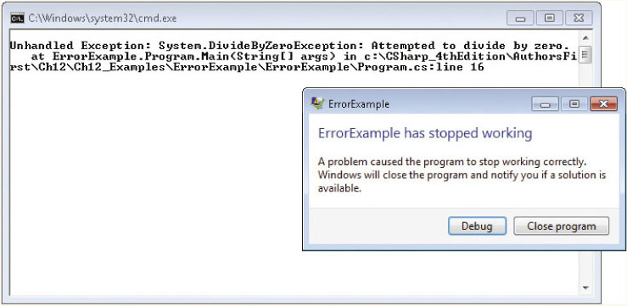
Exceptions (continued)
Dialog box asks you whether you want to have an error report sent to Microsoft
Figure 12-9 Microsoft error reporting

Slide 22
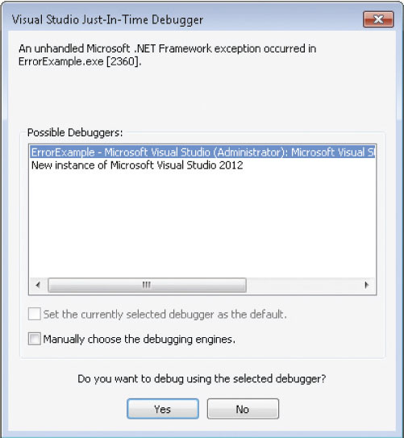
Exceptions (continued)
Normally you do not want to try to debug application while it is running
Click No
Figure 12-10 Just-In-Time Debugger

Slide 23
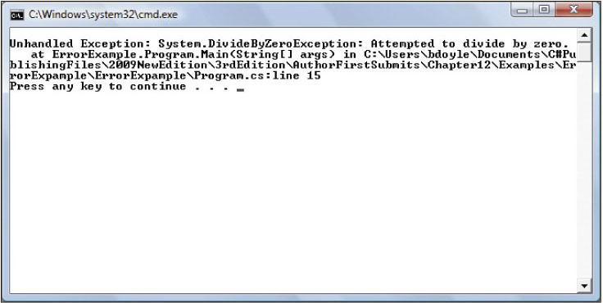
Unhandled Exception
Message displayed when you are creating console application and unhandled exception occurs
Figure 12-11 Unhandled exception in a console application

Slide 24
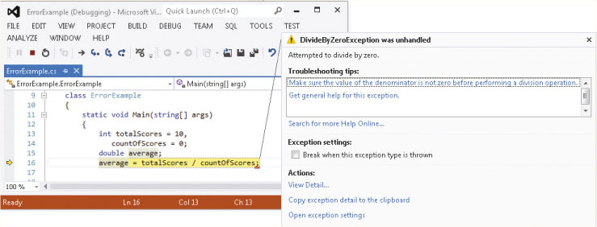
Unhandled Exception (continued)
Selecting Debug>Start to run application in Visual Studio
Yellow arrow marks the error (erroneous code highlighted)
Figure 12-12 Unhandled exception thrown – dividing by zero

Slide 25
Raising an Exception
Error encountered – no recovery
Raise or throw an exception
Execution halts in the current method and the Common Language Runtime (CLR) attempts to locate an exception handler
Exception handler: block of code to be executed when a certain type of error occurs
If no exception handler is found in current method, exception is thrown back to the calling method

Slide 26
Bugs, Errors, and Exceptions
Bugs differ from exceptions
Bugs, also called "programmer mistakes," should be caught and fixed before application released
Errors can be created because of user actions
Example
Entering wrong type of data produces unhandled exception when ParseInt( ) called
Details button in Visual Studio lists a stack trace of methods with the method that raised the exception listed first

Slide 27
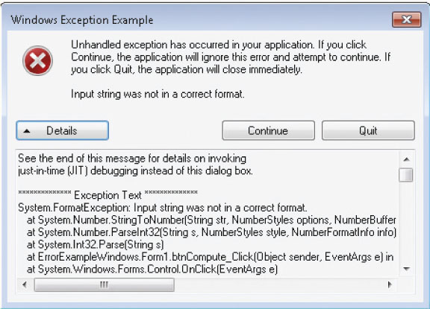
Bugs, Errors, and Exceptions (continued)
Stack trace
Figure 12-13 Unhandled exception raised by incorrect input string

Slide 28
Exception-Handling Techniques
If event creates a problem frequently, best to use conditional expressions to catch and fix problem
Execution is slowed down when CLR has to halt a method and find an appropriate event handler
Exception-handling techniques are for serious errors that occur infrequently
Exceptions classes integrated within the FCL
Used with the try…catch…finally program constructs

Slide 29
Try…Catch…Finally Blocks
Code that may create a problem is placed in the try block
Code to deal with the problem (the exception handler) is placed in catch blocks
catch clause
Code to be executed whether an exception is thrown or not is placed in the finally block

Slide 30
try
{
// Statements
}
catch [ (ExceptionClassName exceptionIdentifier) ]
{
// Exception handler statements
}
: // [additional catch clauses]
[ finally
{
// Statements
} ]
Notice square brackets indicate optional entry
One catch clause required
finally clause optional

Slide 31
Try…Catch…Finally Blocks (continued)
Generic catch clause
Omit argument list with the catch
Any exception thrown is handled by executing code within that catch block
Control is never returned into the try block after an exception is thrown
Using a try…catch block can keep the program from terminating abnormally
Review ExceptionApp Example

Slide 32
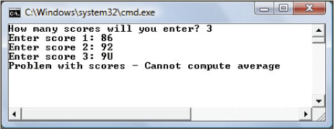
Use of Generic Catch Clause
Example 12-2 uses a generic catch block
Figure 12-14 Generic catch block handles the exception

Slide 33
Use of Generic Catch Clause (continued)
catch
{
Console.WriteLine("Problem with scores - " +
"Cannot compute average");
}
Any type of exception is handled by the generic catch

Slide 34
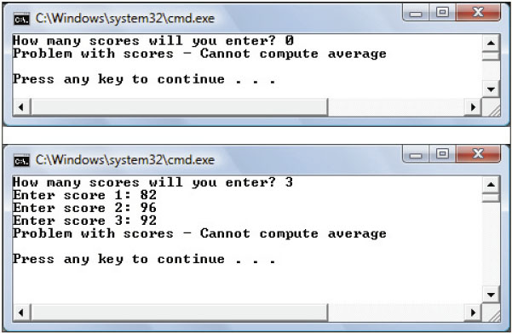
What Caused These Exceptions to be Thrown?
Never quite sure what causes the
exception to be thrown when a generic catch clause is used!
Figure 12-15 Exceptions – division by zero and programmer errors

Slide 35
Exception Object
When an exception is raised, an object is created
Object has properties and behaviors (methods)
Catch clause may list an exception class
Catch { } without exception type does not give you access to an object
Base exception class: Exception
Message property returns a string describing exception
StackTrace property returns a string that contains the called trace of methods

Slide 36
Use of Generic Catch Clause (continued)
catch (System.Exception e)
No filtering of exceptions occurs with (System.Exception e) for the argument list
Any exception that is thrown in this method is caught …because all exceptions are derived from this base System.Exception class

Slide 37
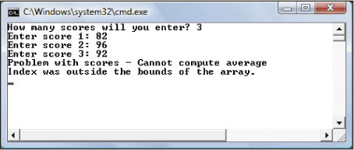
Exception Object (continued)
catch (System.Exception e)
{ Console.Error.WriteLine("Problem with scores - " +
"Can not compute average");
Console.Error.WriteLine(e.Message);
}
Message property lists what exception was thrown
Figure 12-16 Use of Message property with the exception object

Slide 38
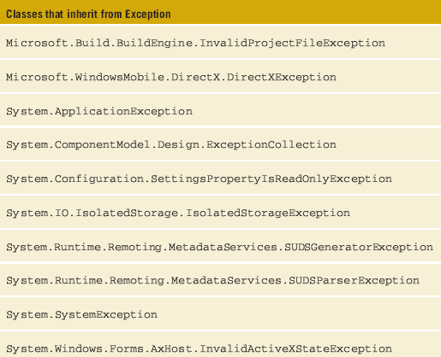
Exception Classes
ApplicationException and SystemException classes form the basis for run-time exceptions
Table 12-1 Derived
classes of the base
Exception class

Slide 39
Exception Classes (continued)
ApplicationException
Derive from this class when you write your own exception classes
User program must throw the exception, not the CLR
SystemException
Most run-time exceptions derive from this class
SystemException class adds no functionality to classes; includes no additional properties or methods

Slide 40
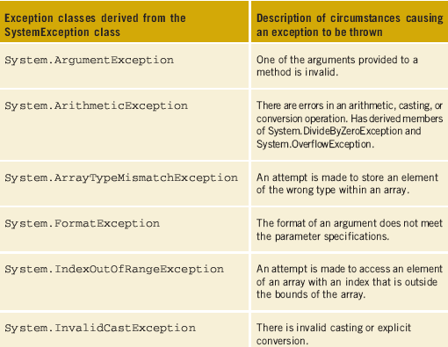
SystemException Class
More than 70 classes derived from SystemException
Table 12-2 Derived
classes of the
SystemException
class

Slide 41
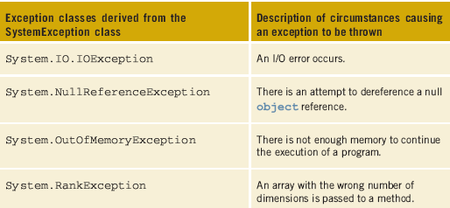
SystemException Class (continued)
Table 12-2 Derived classes of the SystemException class (continued)

Slide 42
System.DivideByZeroException
Derived class of System.ArithmeticException class
Thrown when an attempt to divide by zero occurs
Only thrown for integral or integer data types
Floating-point operands do not throw an exception
Result reported as either positive infinity, negative infinity, or Not-a-Number (NaN)
Follows the rules from IEEE 754 arithmetic

Slide 43
Filtering Multiple Exceptions
Can include multiple catch clauses
Order of placement is important
Enables writing code specific to thrown exception
Review MultipleCatches Example

Slide 44
Filtering Multiple Exceptions
Place catch clauses from most specific to most generic
If Exception class is included, it should always be placed last
try {// statements omitted }
catch (System.FormatException e) { // statements omitted}
catch (System.DivideByZeroException e) { // statements omitted}
catch (System.ArithmeticException e) { // statements omitted}
catch (System.Exception e) { // statements omitted}
finally { // statements omitted}

Slide 45
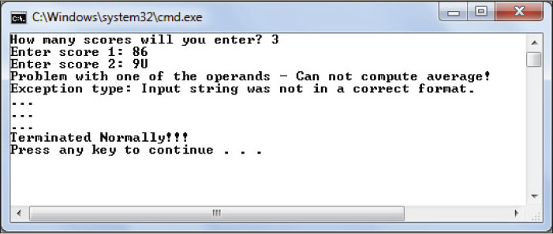
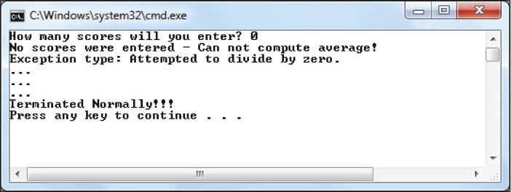
Filtering Multiple Exceptions (continued)
Figure 12-7 Number
FormatException
thrown
Figure 12-8
DivideByZero
exception thrown

Slide 46
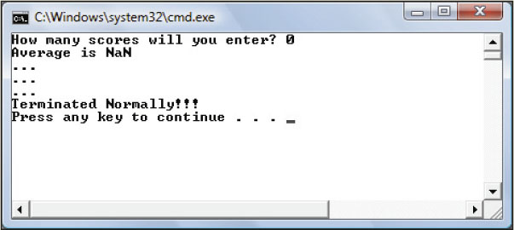
Filtering Multiple Exceptions (continued)
averageTestScore = (double)totalScores / countOfScores;
Figure 12-19 Floating-point division by zero

Slide 47
Custom Exceptions
Derive from the ApplicationException class
Good idea to use the word “Exception” as part of the identifier
Creating an exception class is no different from creating any other class

Slide 48
Custom Exceptions (continued)
public class FloatingPtDivisionException :
System.ApplicationException
{
public FloatingPtDivisionException
(string exceptionType)
: base (exceptionType)
{
// Empty body
}
}
String argument sent to the base
constructor indicating type of exception

Slide 49
public class TestOfCustomException
{
static void Main(string[ ] args)
{
double value1 = 0, value2=0, answer;
try
{ //Could include code to enter new values.
answer = GetResults(value1, value2);
}
catch (FloatingPtDivisionException excepObj)
{
Console.Error.WriteLine(excepObj.Message);
}
catch
{
Console.Error.WriteLine("Something else " + "happened!");
} }
User-defined class

Slide 50
Throwing an Exception
Exception object is instantiated when “an exceptional condition occurs”
Can be any condition, but should be one that happens infrequently
After object is instantiated, object is thrown
Exception is thrown by the program using the throw keyword

Slide 51
static double GetResults (double value1, double value2)
{
if (value2 < .0000001) // Be careful comparing floating-
// point values for equality.
{
FloatingPtDivisionException excepObj = new
FloatingPtDivisionException
("Exception type: " +
"Floating-point division by zero");
throw excepObj;
}
return value1 / value2;
}
}
Throwing an exception

Slide 52
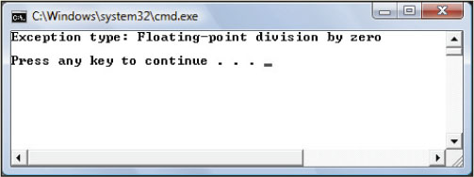
Custom Exceptions (continued)
Figure 12-20 TestOfCustomException threw
FloatingPtDivisionException exception

Slide 53
Input Output (IO) Exceptions
System.IO.IOException
Direct descendent of Exception
Thrown when a specified file or directory is not found
Thrown when program attempts to read beyond the end of a file
Thrown when there are problems loading or accessing the contents of a file

Slide 54
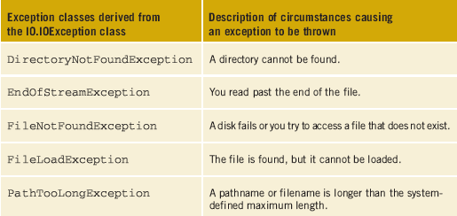
Input Output (IO) Exceptions (continued)
Table 12-3 Derived classes of IO.IOException

Slide 55
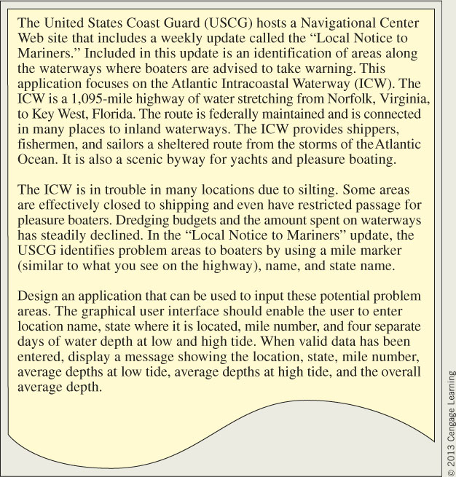
ICW WaterDepth Application
Figure 12-21 Problem specification for WaterDepth application

Slide 56
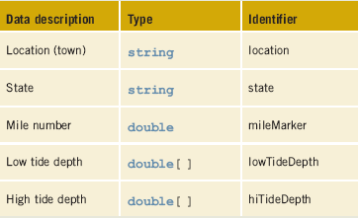
ICW WaterDepth Application (continued)
Table 12-4 ShoalArea class data fields

Slide 57
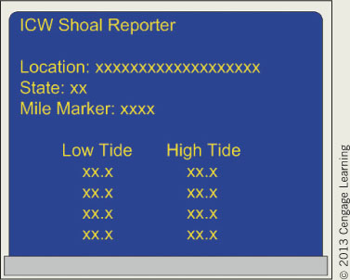
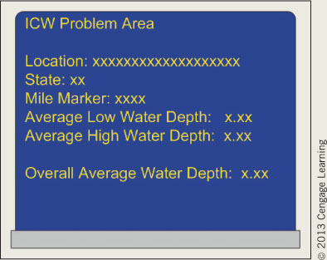
ICW WaterDepth Application (continued)
Figure 12-22 Prototype for
WaterDepth
input form
Figure 12-23 Prototype for
WaterDepth
final output

Slide 58
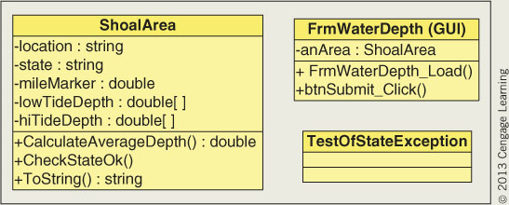
ICW WaterDepth Application (continued)
Figure 12-24 Class diagrams for WaterDepth application

Slide 59
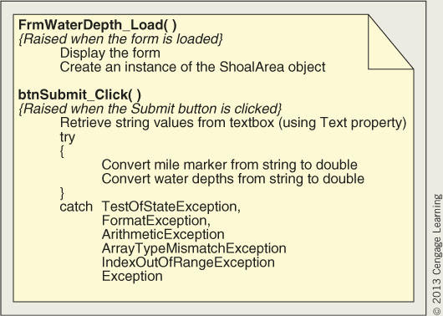
ICW WaterDepth Application (continued)
Figure 12-25 Behavior for the FrmWaterDepth class

Slide 60
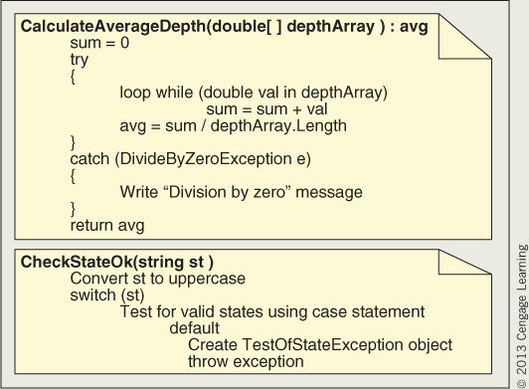
ICW WaterDepth Application (continued)
Figure 12-26 Behavior of the ShoalArea class

Slide 61
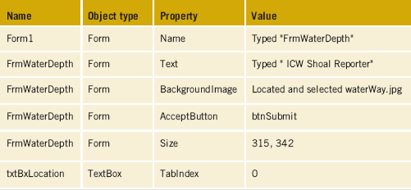
ICW WaterDepth Application (continued)
Table 12-5 WaterDepth property values

Slide 62
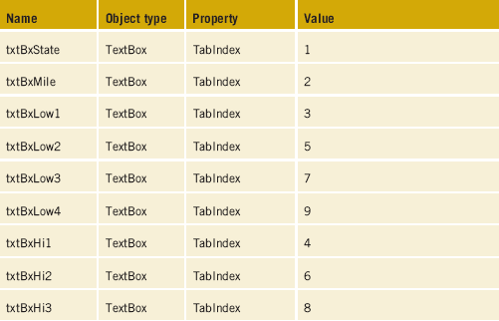
ICW WaterDepth Application (continued)
Table 12-5 WaterDepth property values (continued)

Slide 63
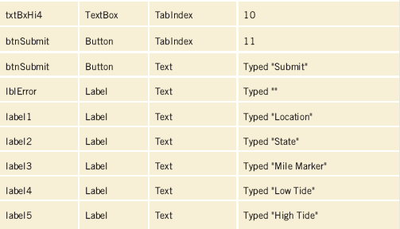
ICW WaterDepth Application (continued)
Table 12-5 WaterDepth property values (continued)

Slide 64
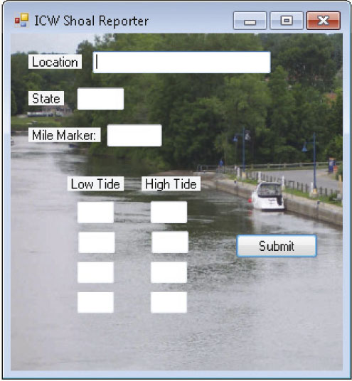
ICW WaterDepth Application (continued)
Figure 12-27 FrmWaterDepth form

Slide 65
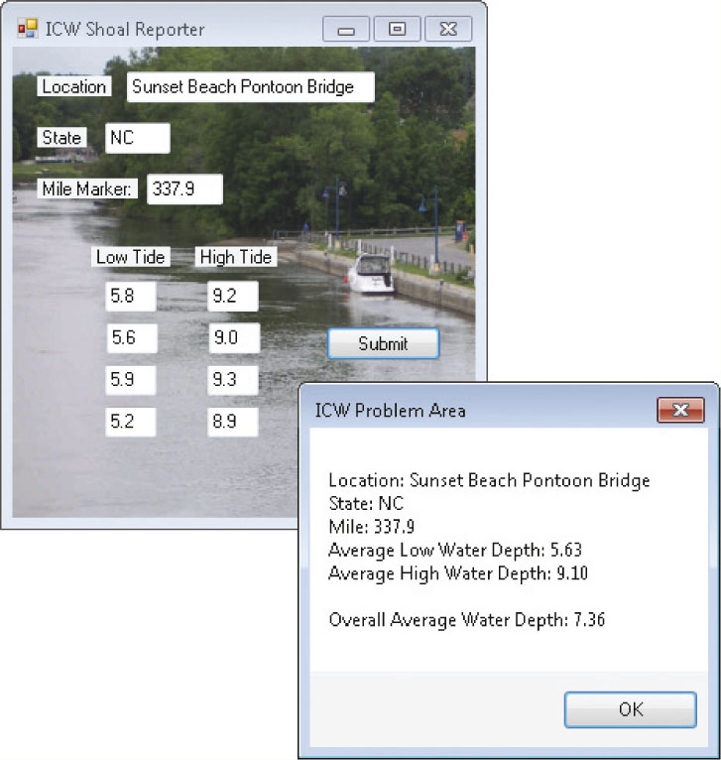
ICW WaterDepth Application (continued)
Figure 12-28 WaterDepth application output

Slide 66
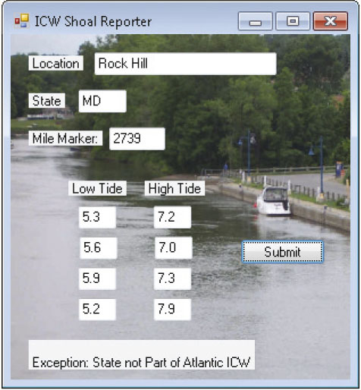
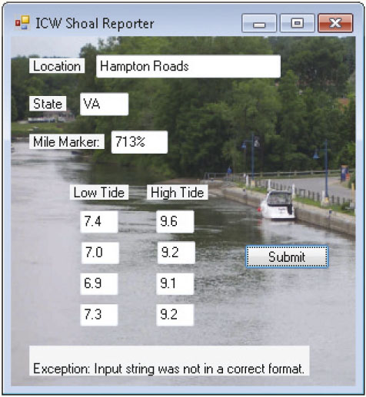
ICW WaterDepth Application (continued)
Figure 12-29 State exception
thrown
Figure 12-30 Invalid input
exception

Slide 67
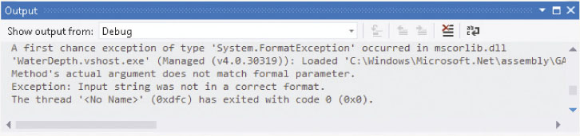
ICW WaterDepth Application (continued)
Figure 12-31 Debug information sent to Output window

Slide 68
Coding Standards
Avoid using exception-handling techniques to deal with problems that can be handled with reasonable coding effort
Encapsulating all methods in a try. . .catch block hampers performance
Order exceptions from the most specific to the least specific
Add Exception onto the end of the name for custom classes

Slide 69
Resources
The C# Corner - Exception-Handling articles –
http://www.c-sharpcorner.com/
msdn Exceptions and Exception Handling (C# Programming Guide) –
http://msdn.microsoft.com/en-us/library/ms173160.aspx
CSharpFriends - Exception Handling in C# –
http://www.csharpfriends.com/Articles/getArticle.aspx?articleID=128
CodeGuru - Error Handling –
http://www.codeguru.com/csharp/csharp/cs_syntax/errorhandling/

Slide 70
Chapter Summary
Types of errors
Debugger
Halt execution to examine code
Breakpoints
Locals window shows variables in scope
Step Into, Step Over, and Step Out
Exceptions
Unexpected conditions
Abnormal termination if not handled

Slide 71
Chapter Summary (continued)
Exceptions
How to throw and catch exceptions
Exception-handling techniques
try…catch…finally clauses
Exception object
Exception classes
Application Exception
SystemException

Slide 72
Chapter Summary (continued)
Generic catch clauses
Filter multiple catch clauses
Placement of catch clauses
Create custom Exception classes
Throw exception
Input Output Exceptions

